Slide 1
Client Manager Enhancements SGOS 5.4
Andrew Kiggins
December 2008

Slide 2
Overview - Goals
ProxyClient Persistence
  Ensures that information about the active and inactive ProxyClients is maintained across system reboots
ProxyClient AdvancedURL To MC
  Makes ProxyClient AdvancedURL information available at the MC UI in a more usable format
    Search and sort
    Information grouping
ProxyClient MC Configuration Enhancements
  Streamline the workflow and error handling for ProxyClient Webfiltering and Acceleration

Slide 3
ProxyClient Persistence

Slide 4
ProxyClient Persistence – Basic Operation
Pre 5.4 ProxyClient data is not restored across reboots
5.4 Client Manager periodically snapshots the state of the ProxyClients
  Inactive client count
  Active client count
Snapshot restored after reboot

Slide 5
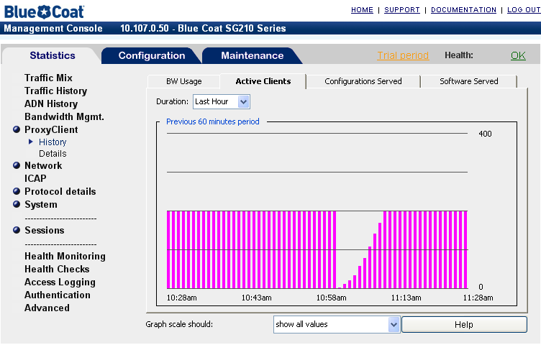
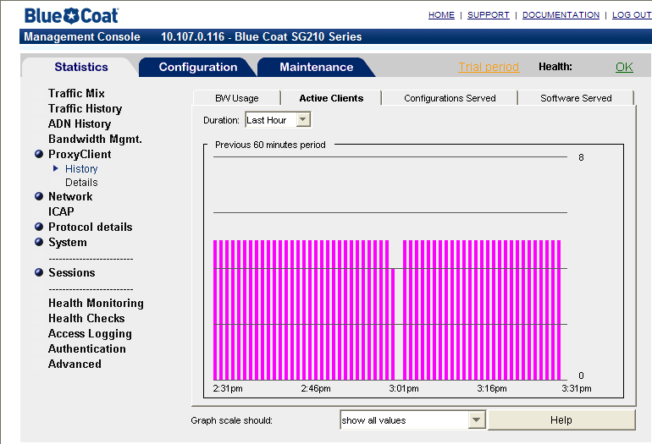
ProxyClient Persistence
Pre-5.4
Active ProxyClient count drops to zero and slowly recovers as ProxyClients reconnect
5.4 onwards
Active ProxyClient counts are maintained and restored after a reboot
Reboot

Slide 6
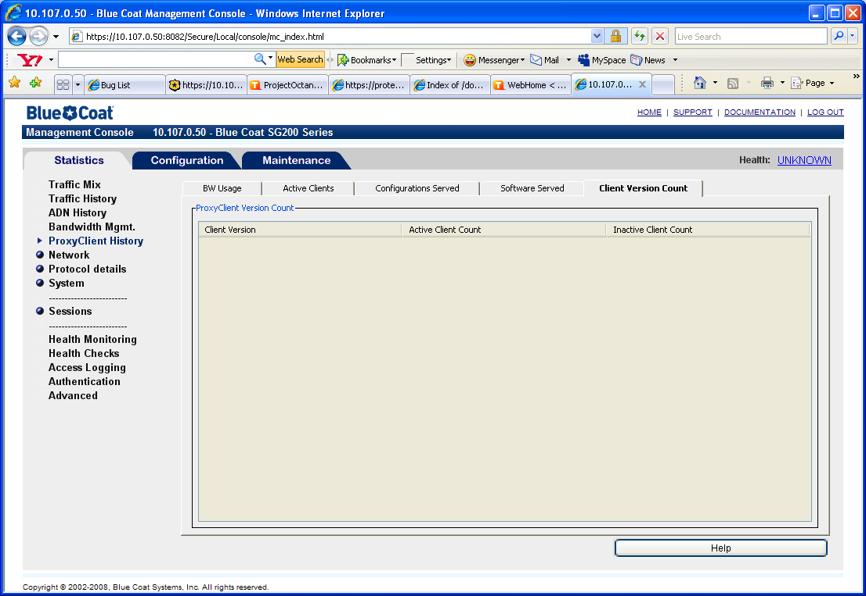
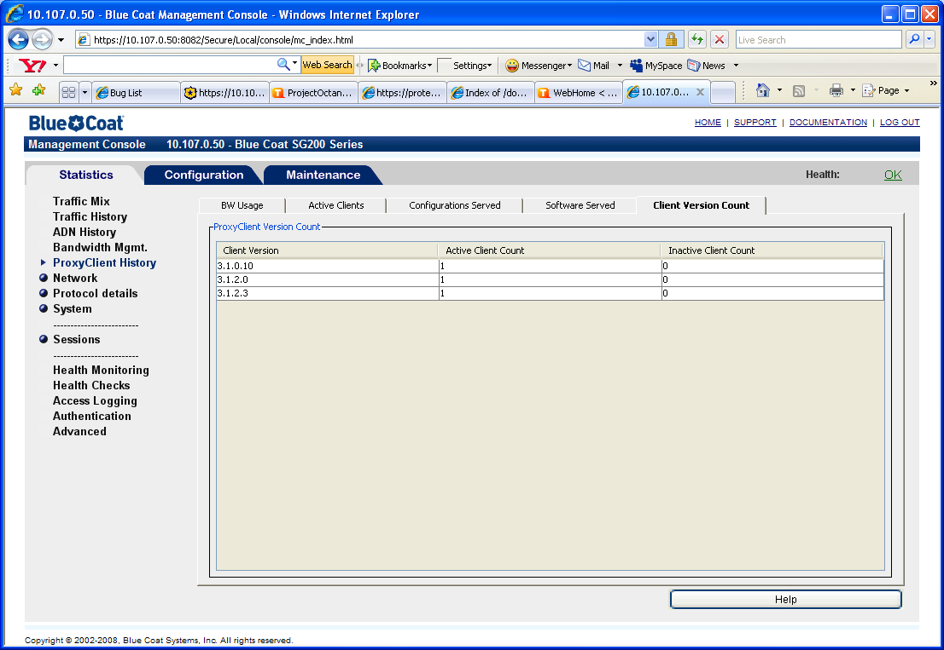
ProxyClient Persistence
Pre 5.4
After a reboot the client counts in the ProxyClient History panel will be inaccurate
5.4 onwards
After a reboot the client counts in the ProxyClient->Details(Client Version Count) panel will be immediately valid
Note the information has been moved from the ProxyClient History panel to the ProxyClient->Details(Client Version Count) panel

Slide 7
ProxyClient Persistence - Errata
There is a small period of time where a discrepancy can occur
  If clients are become inactive or active between that last snapshot and the system being cold started then the recovered data will be inaccurate.

Slide 8
ProxyClient Persistence – additional commands
Explicit clear of all ProxyClients
  10.107.0.50 - Blue Coat SG200 Series#(config proxy-client)clear ?
  inactive | all

Slide 9
ProxyClient AdvancedURL To MC UI

Slide 10
ProxyClient AdvancedURL To MC
Move the ProxyClient->AdvancedURL to MC UI
New Tabs Added to ProxyClient->Details Panel
  ClientDetails subpanel contains 4 tabs
    General – summary information
    Acceleration – ADN specific information
    Filtering – WebFiltering specific information
    All – all information
  Client Version Count contains the same information as previous version

Slide 11
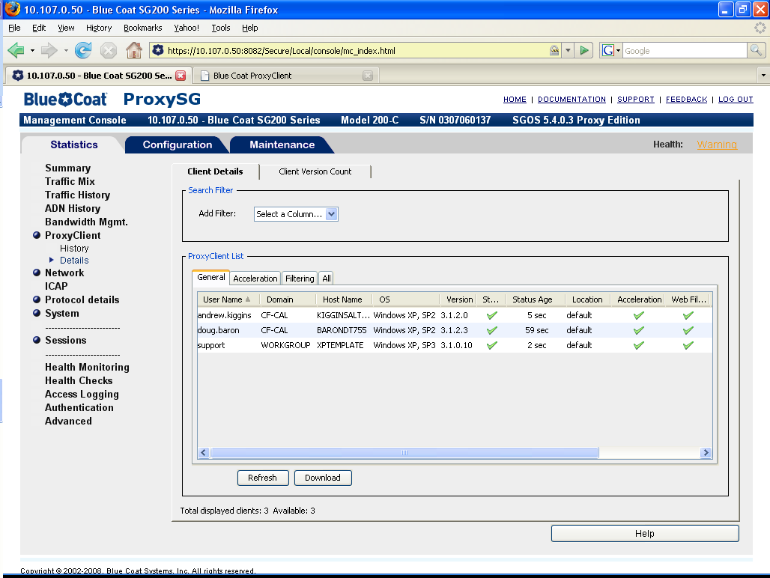
ProxyClient AdvancedURL To MC
General Tab

Slide 12
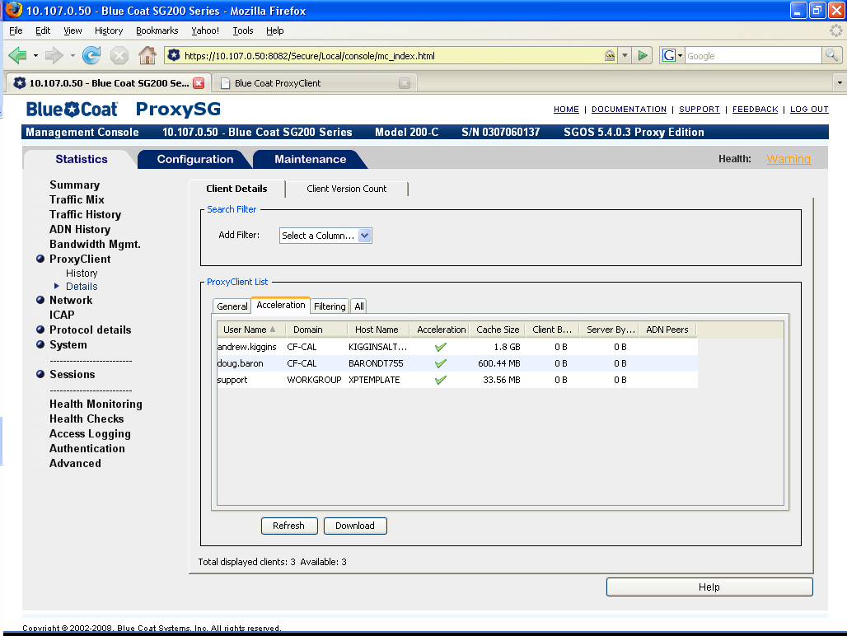
ProxyClient AdvancedURL To MC
Acceleration Tab

Slide 13

ProxyClient AdvancedURL To MC
Filtering Tab

Slide 14
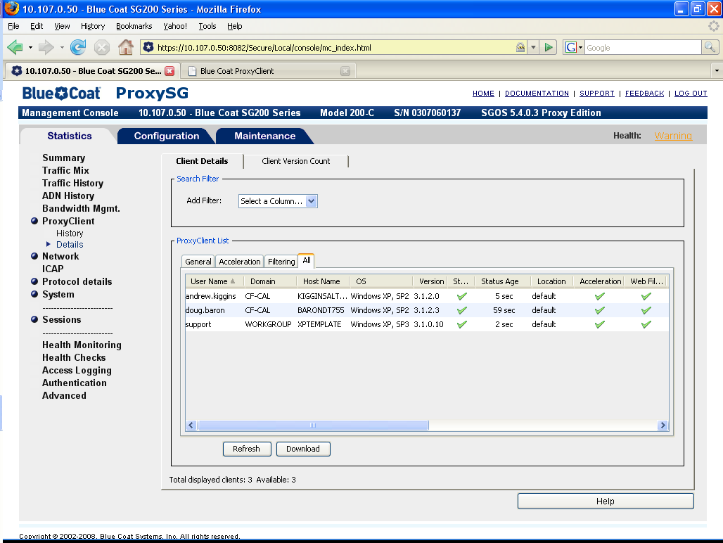
ProxyClient AdvancedURL To MC
Everything Tab

Slide 15
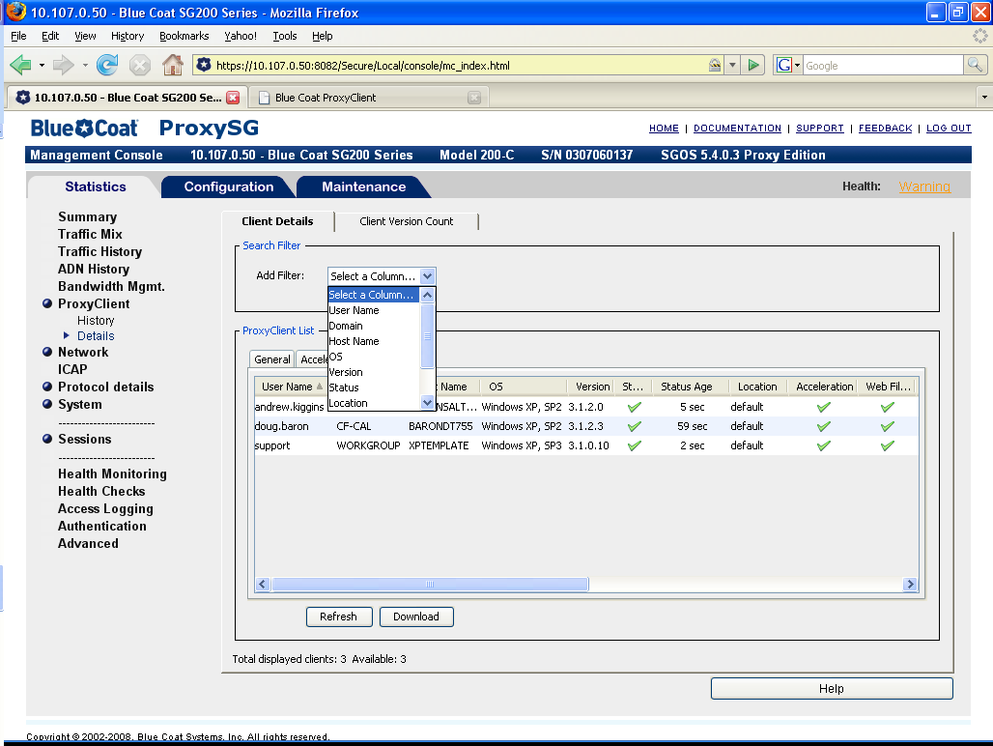
ProxyClient AdvancedURL To MC
Filterable fields

Slide 16

ProxyClient AdvancedURL To MC
Rows sorted by username

Slide 17
ProxyClient AdvancedURL To MC
Filtering
  Filtering is done by a substring match on the selected field, e.g. “or” will match Forrest.Gump and support
Sorting
  Row sorting is done based on the values in each column
  Text fields are sorted alphanumerically
  Integer value fields are sorted numerically

Slide 18
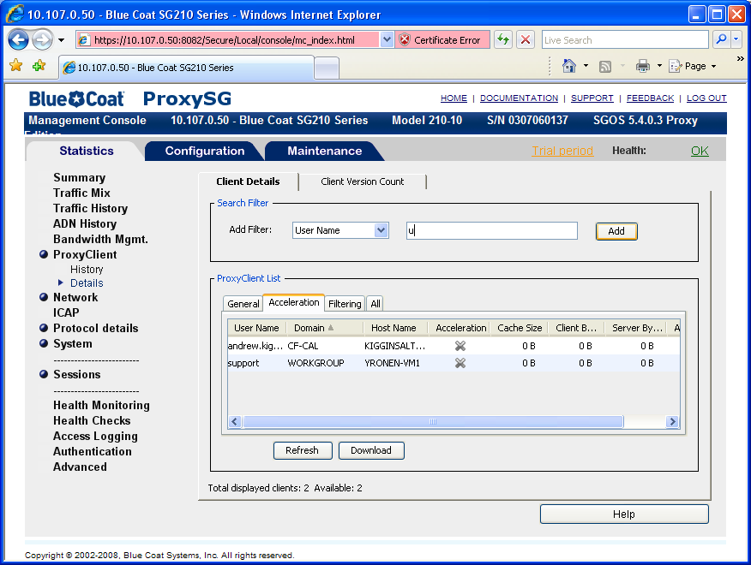
ProxyClient AdvancedURL To MC
Filters pop up the appropriate input field.
Text Field for alphanumeric
Dropdown for restricted selections

Slide 19
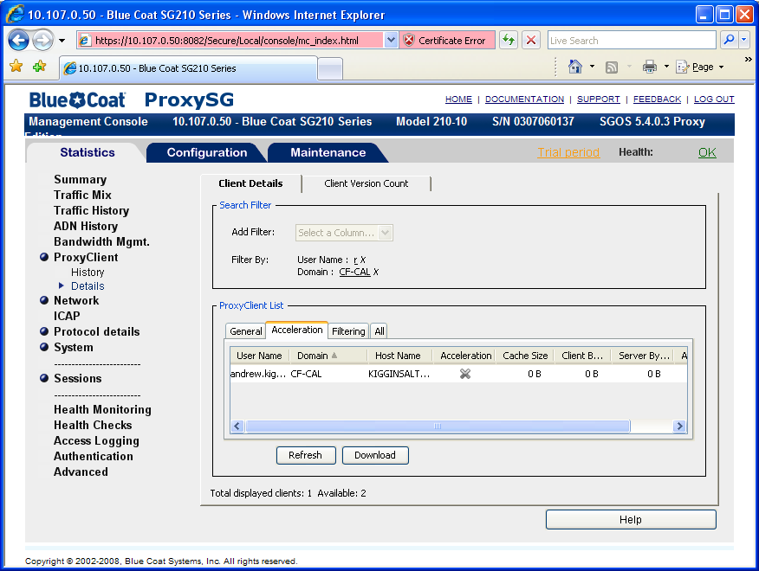
ProxyClient AdvancedURL To MC
Filtered by “UserName” containing ‘r’ and “Domain” is CF-CAL
Multiple filters ‘AND’ together

Slide 20
ProxyClient MC Configuration Enhancements

Slide 21
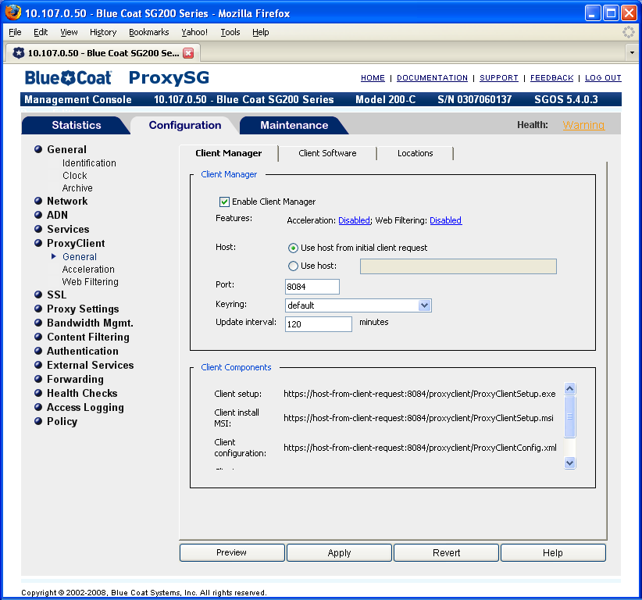
ProxyClient MC Configuration Enhancements - General
Status reflected in one place
Hyperlinks to help configuration workflow

Slide 22
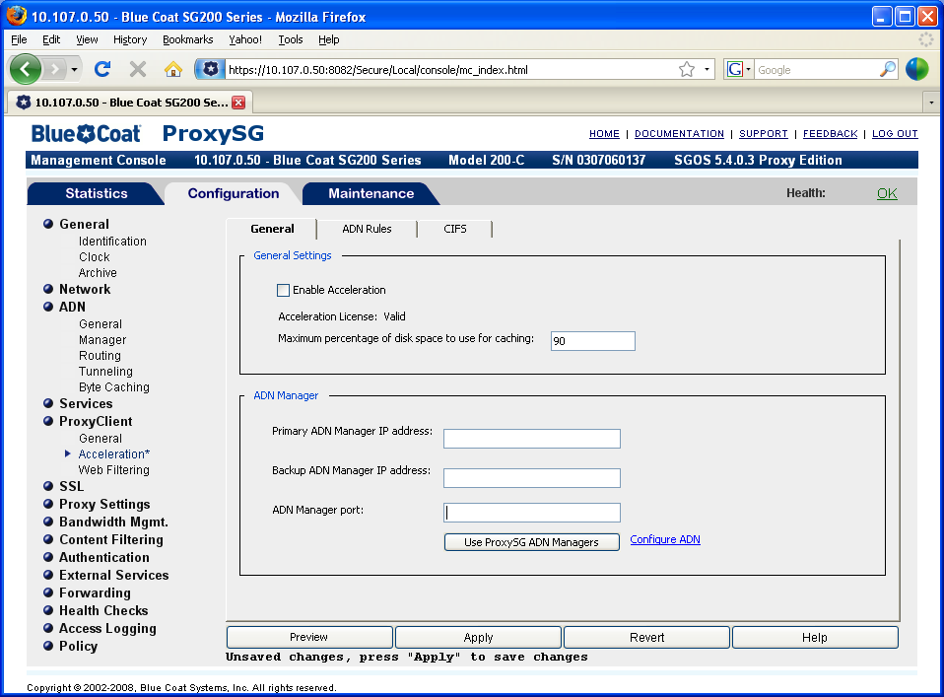
ProxyClient MC Configuration Enhancements - Acceleration
Import settings from the ADN->General page

Slide 23
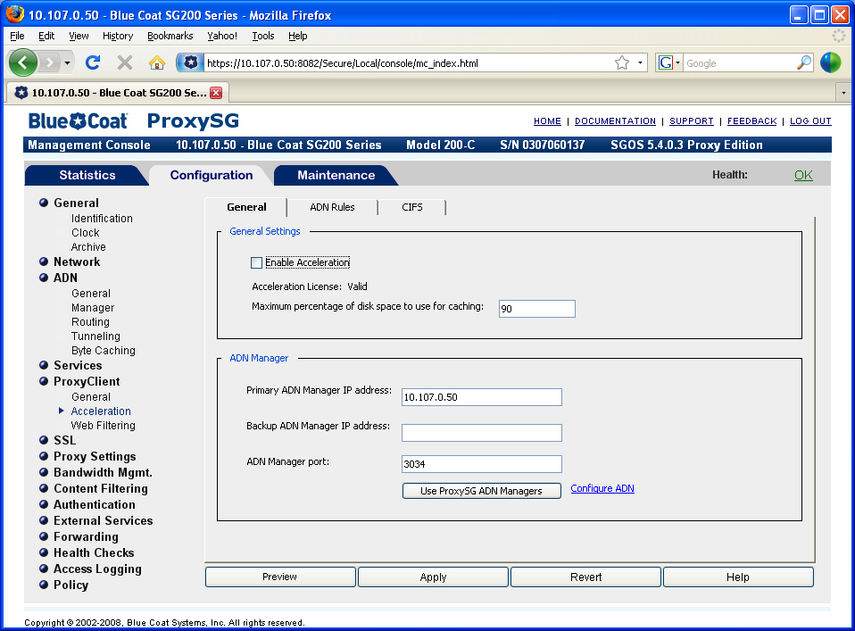
ProxyClient MC Configuration Enhancements - Acceleration

Slide 24
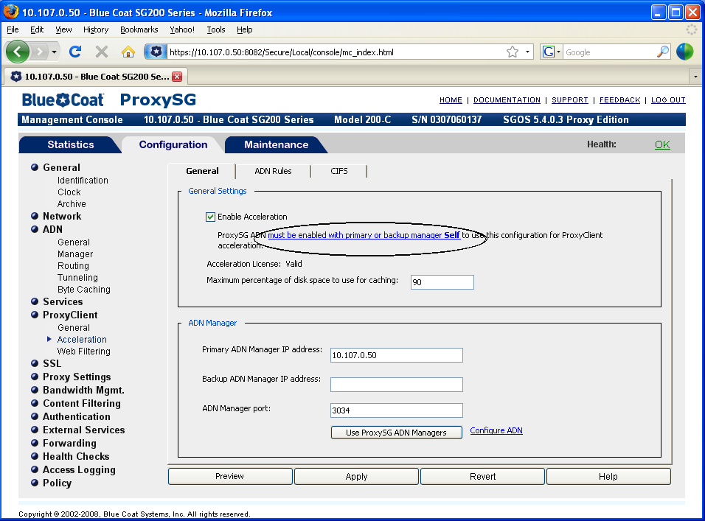
ProxyClient MC Configuration Enhancements - Acceleration
Hyperlink to ADN->General page

Slide 25
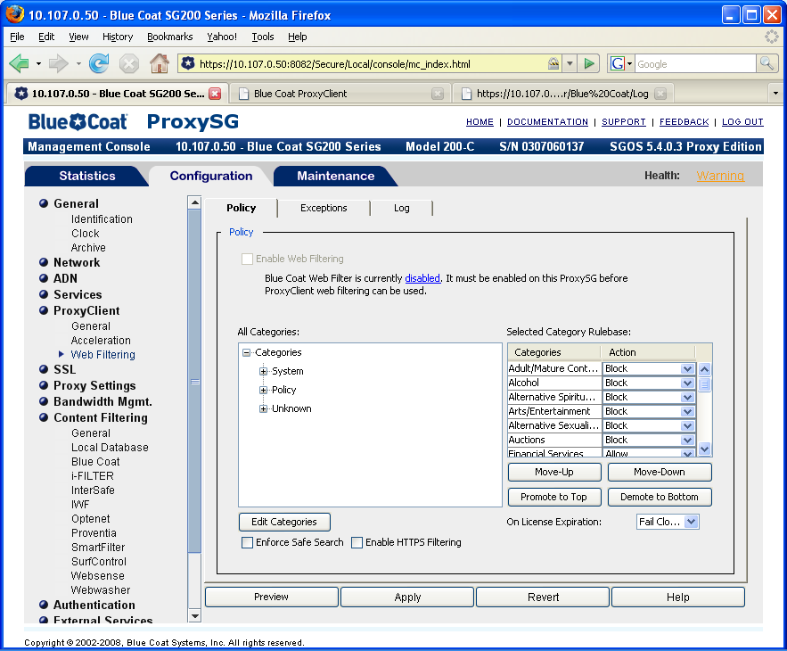
ProxyClient MC Configuration Enhancements – Webfiltering
Can’t prematurely shoot yourself in the foot
Hyperlink to help workflow

Slide 26
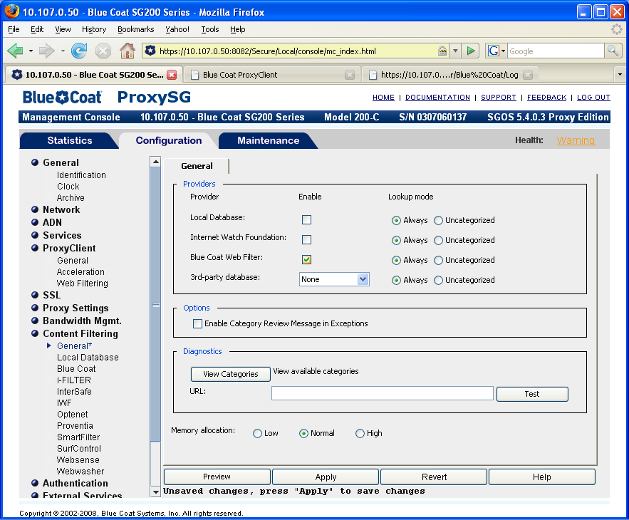
ProxyClient MC Configuration Enhancements – Webfiltering
You have to enable Blue Coat Web Filter to proceed

Slide 27
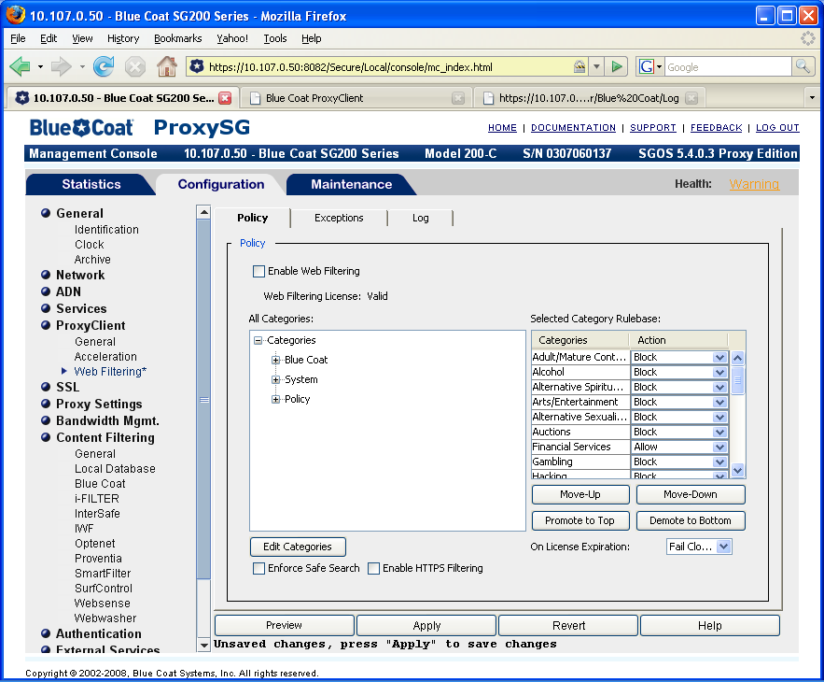
ProxyClient MC Configuration Enhancements – Webfiltering
Enable ProxyClient WebFiltering now possible

Slide 28
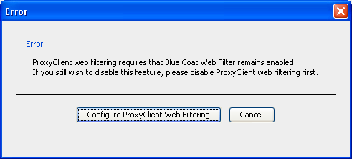
ProxyClient MC Configuration Enhancements – Webfiltering
If you try to disable the Blue Coat Web Filter while ProxyClient WebFiltering is enabled the action will be blocked and a popup will enable you to navigate to the ProxyClient configuration panel

Slide 29
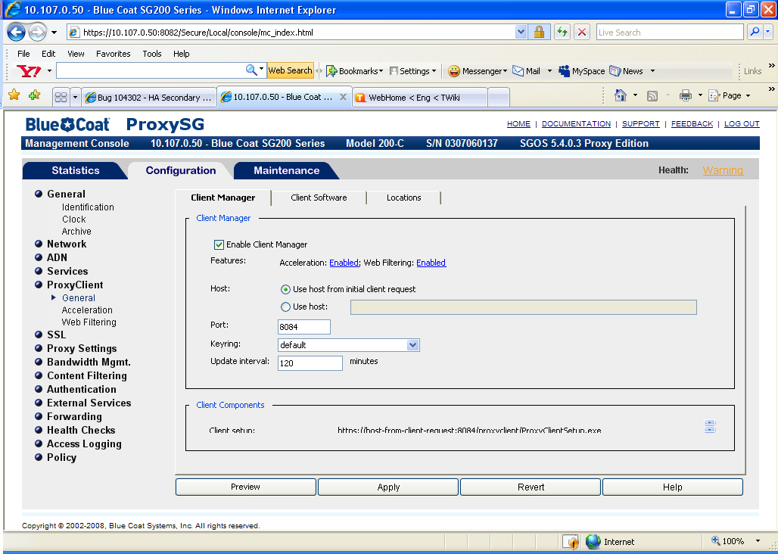
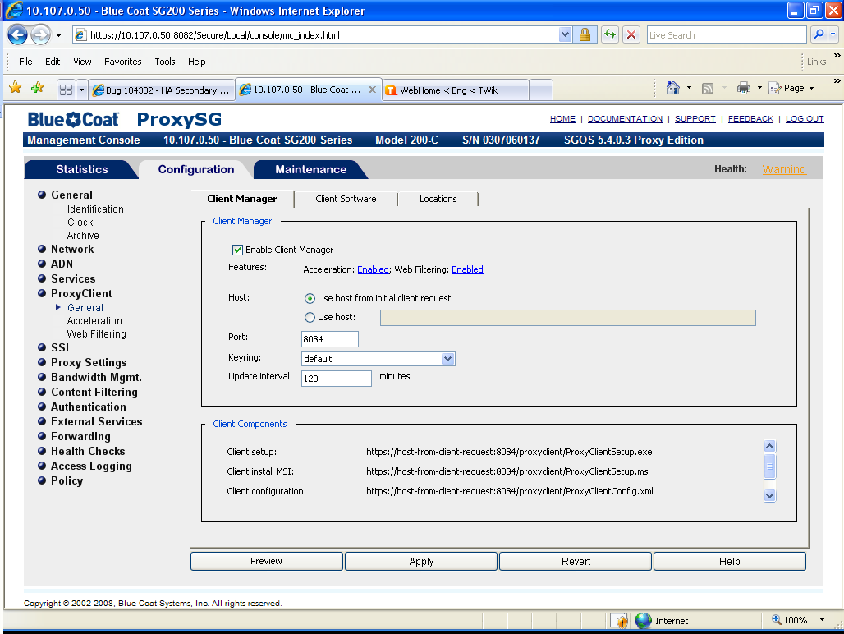
Glitches – 1024x768 + toolbars + locked Taskbar

Slide 30
References
Client Manager Persistence FS – Andrew Kiggins
https://proteus.bluecoat.com/docs/DesignDocs/SGClient/ClientManagerPersistenceFS.doc
ProxyClient AdvancedURL To MC Feature Design
- Andrew Kiggins
https://proteus.bluecoat.com/docs/DesignDocs/SGClient/ProxyClient%20AdvancedURL%20To%20MC.doc
ProxyClient MC Configuration Enhancements FS – Doug Baron
https://proteus.bluecoat.com/docs/DesignDocs/SGClient/Octane-ProxyClient-MC-FS.doc

